Slide 1


A clustering approach to find and correct misidentified bacterial genomes in GenBank
Siva Kannan
National Center for Biotechnology Information (NCBI)
Notes:
NCBI

Slide 2
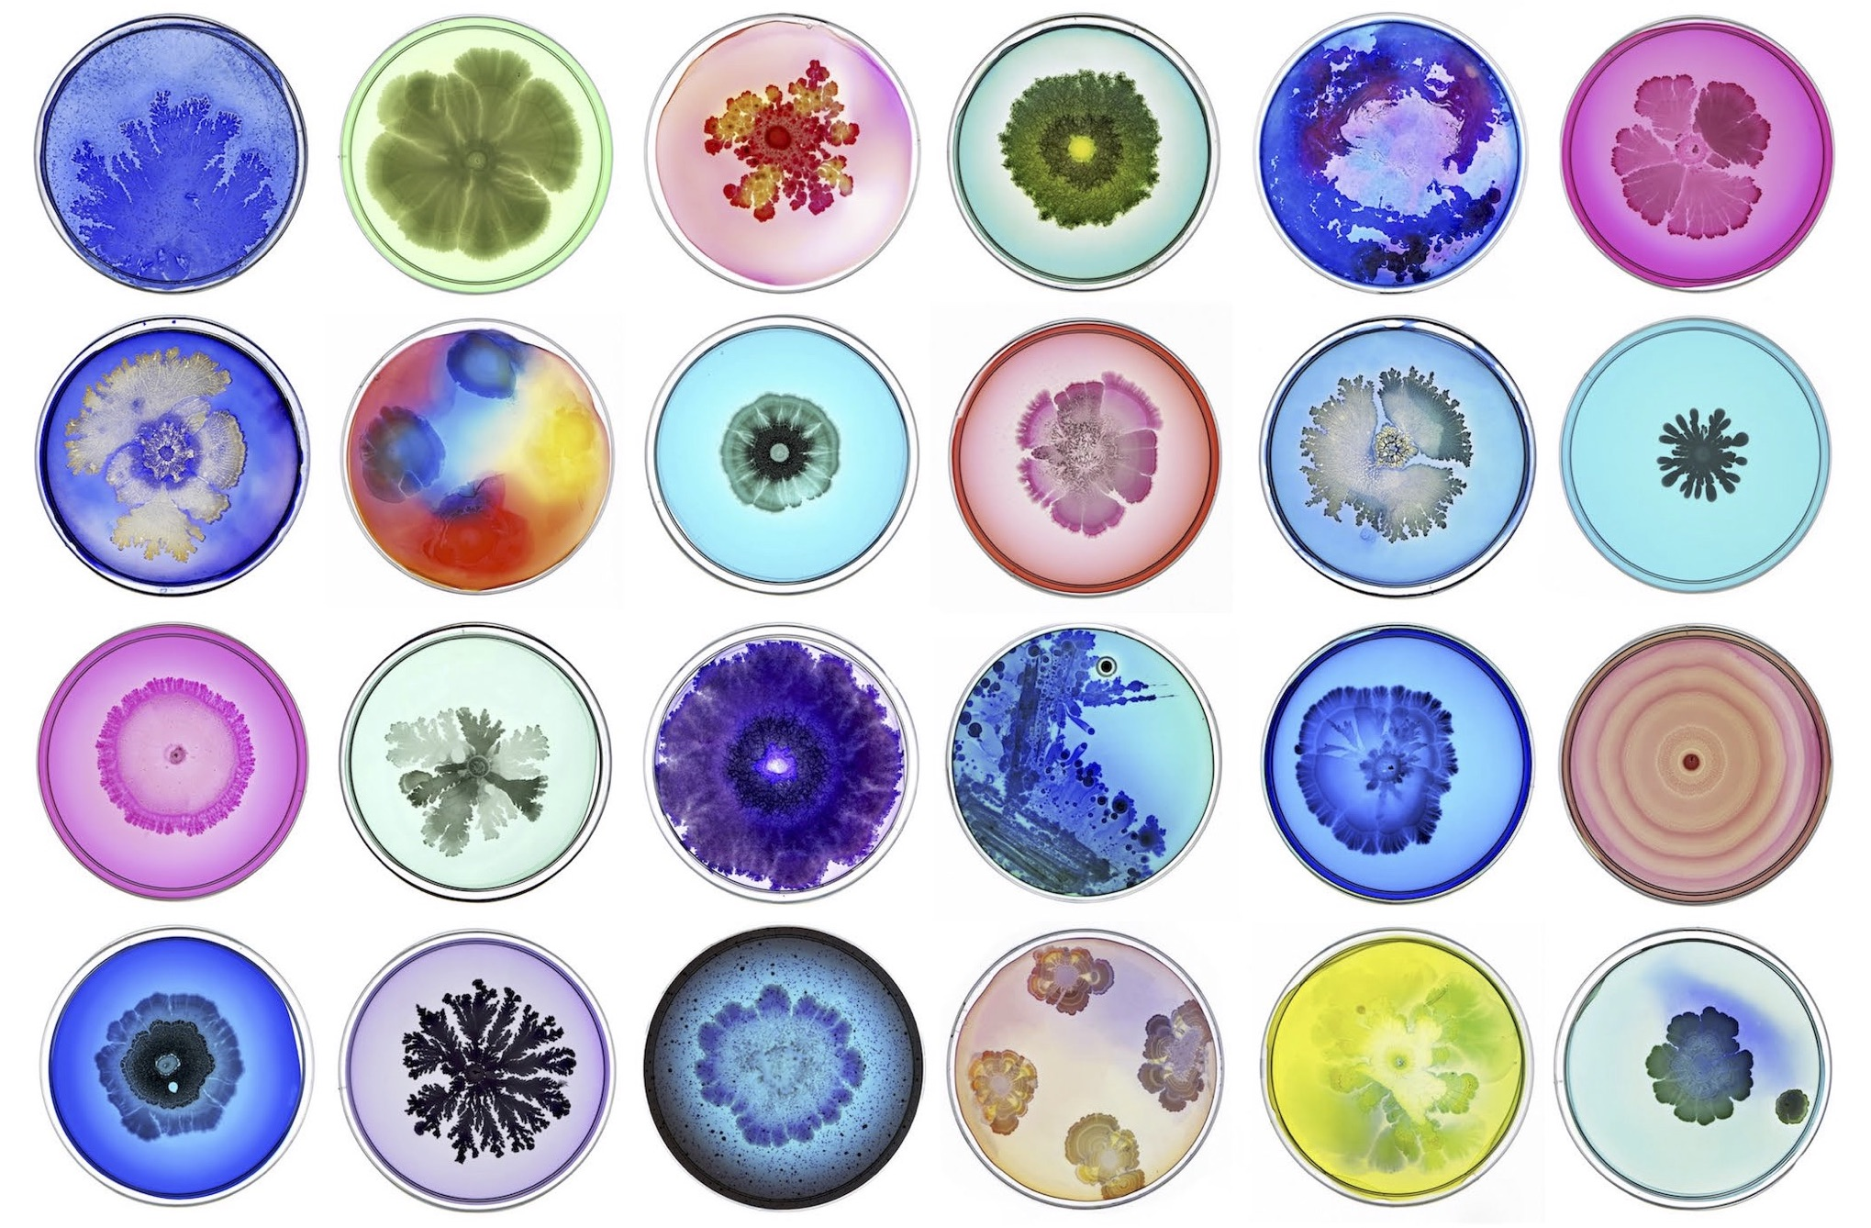
Identifying bacterial genomes
Source: http://www.taldanino.com/bacteria-gallery-1/

Slide 3
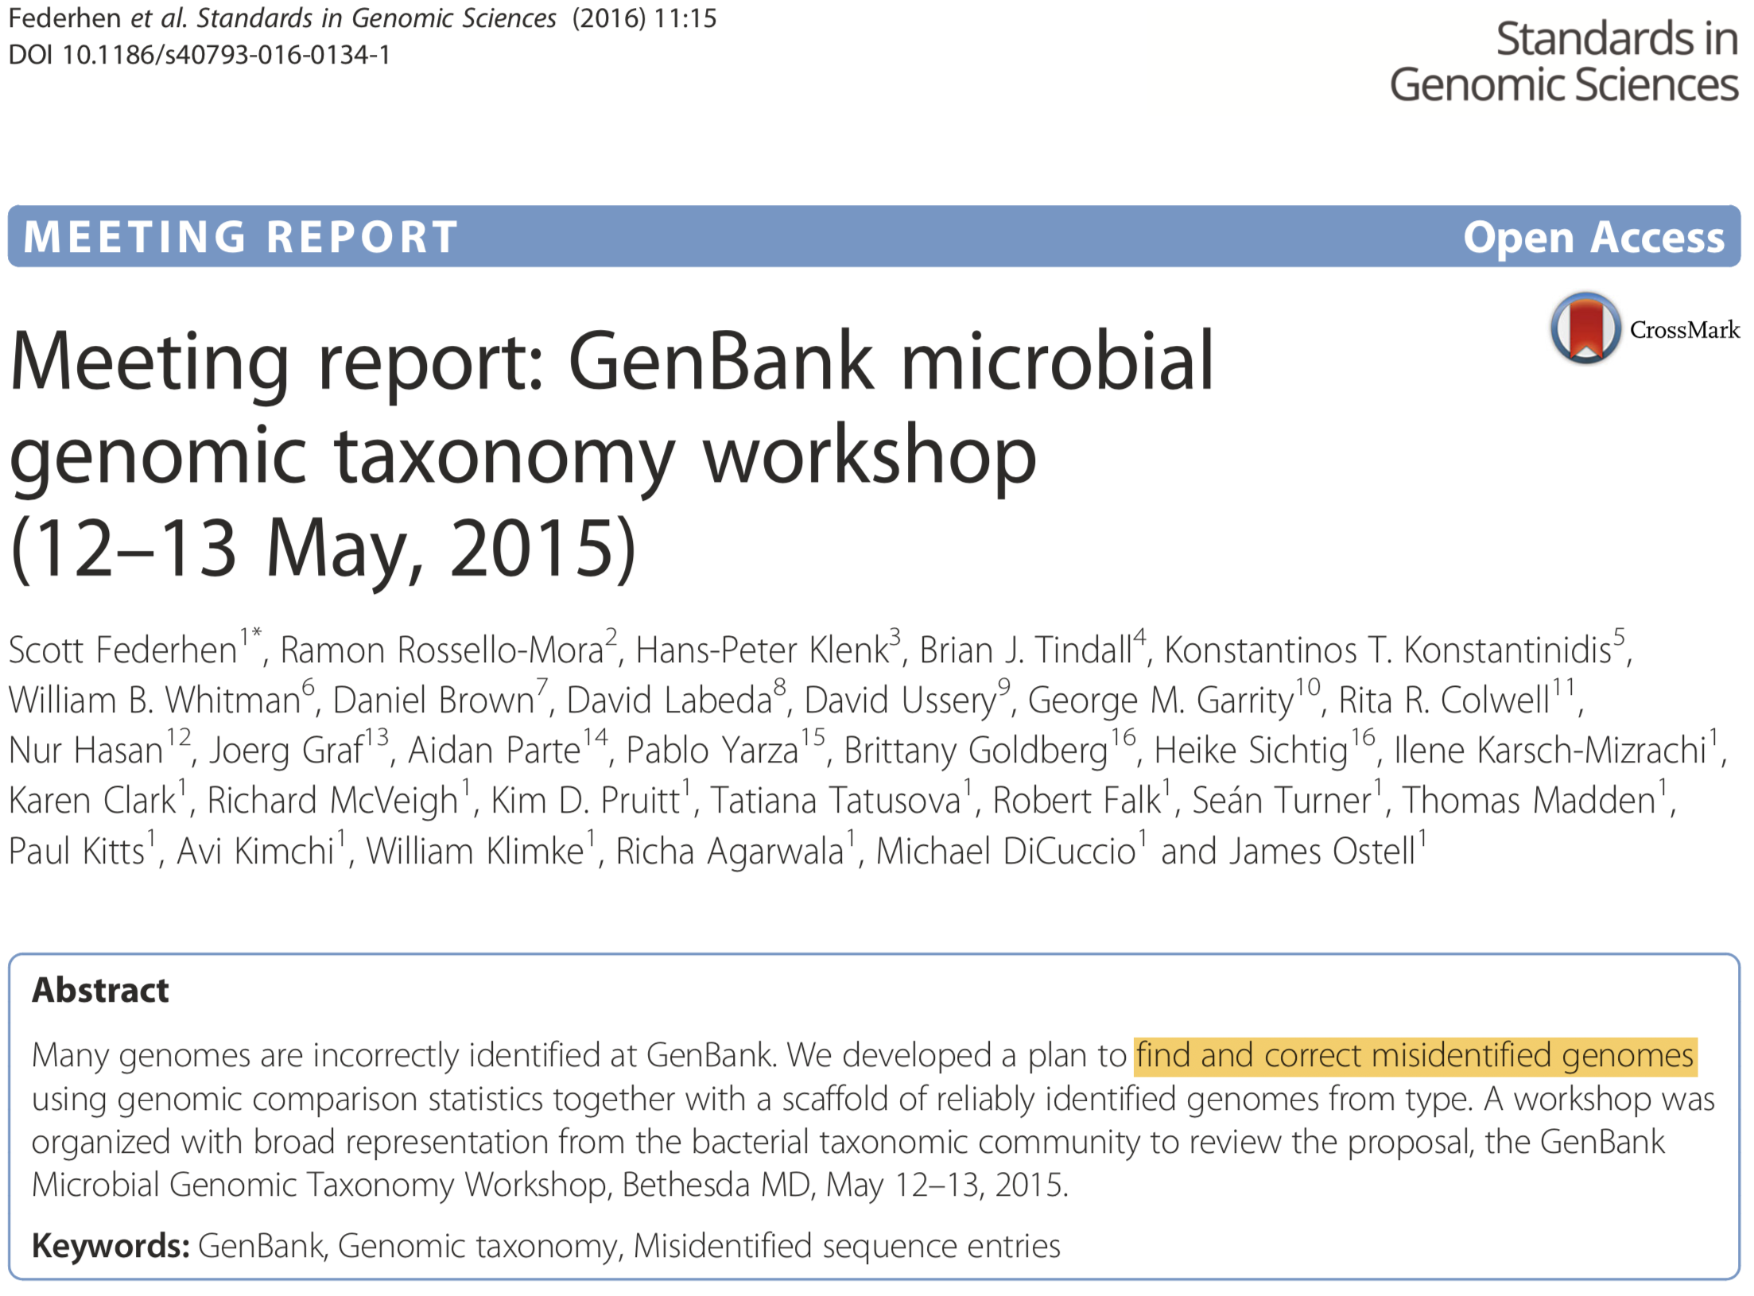

Slide 4
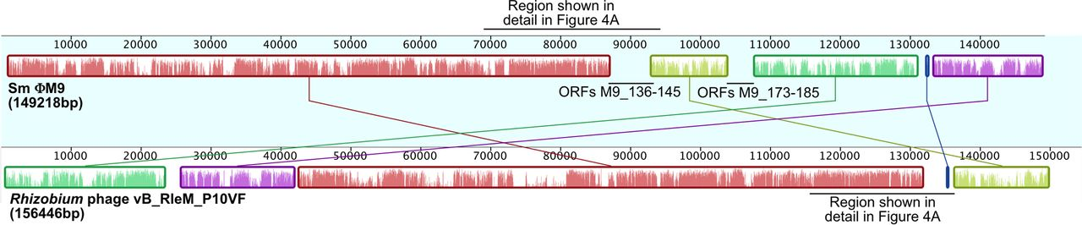
Symmetric identity between two genomes
Whole-genome alignment ΦM9 and Rhizobium phage P10VF
Matthew C. Johnson et al. J. Virol. 2015;89:10945-10958

Slide 5
Clustering to find misidentified genomes
Species
36,225
Type genome
8,618
Non-Type genome
140,026
Compute symmetric identity (all-vs-all)
10,501,881
Clustering
A
C
B

Slide 7
Challenges
Learn about different clustering methods and algorithms
Symmetry identity threshold to use to partition clusters
Plan of action
Explore different clustering methods starting with k-means and density-based clustering (DBSCAN)

Slide 8
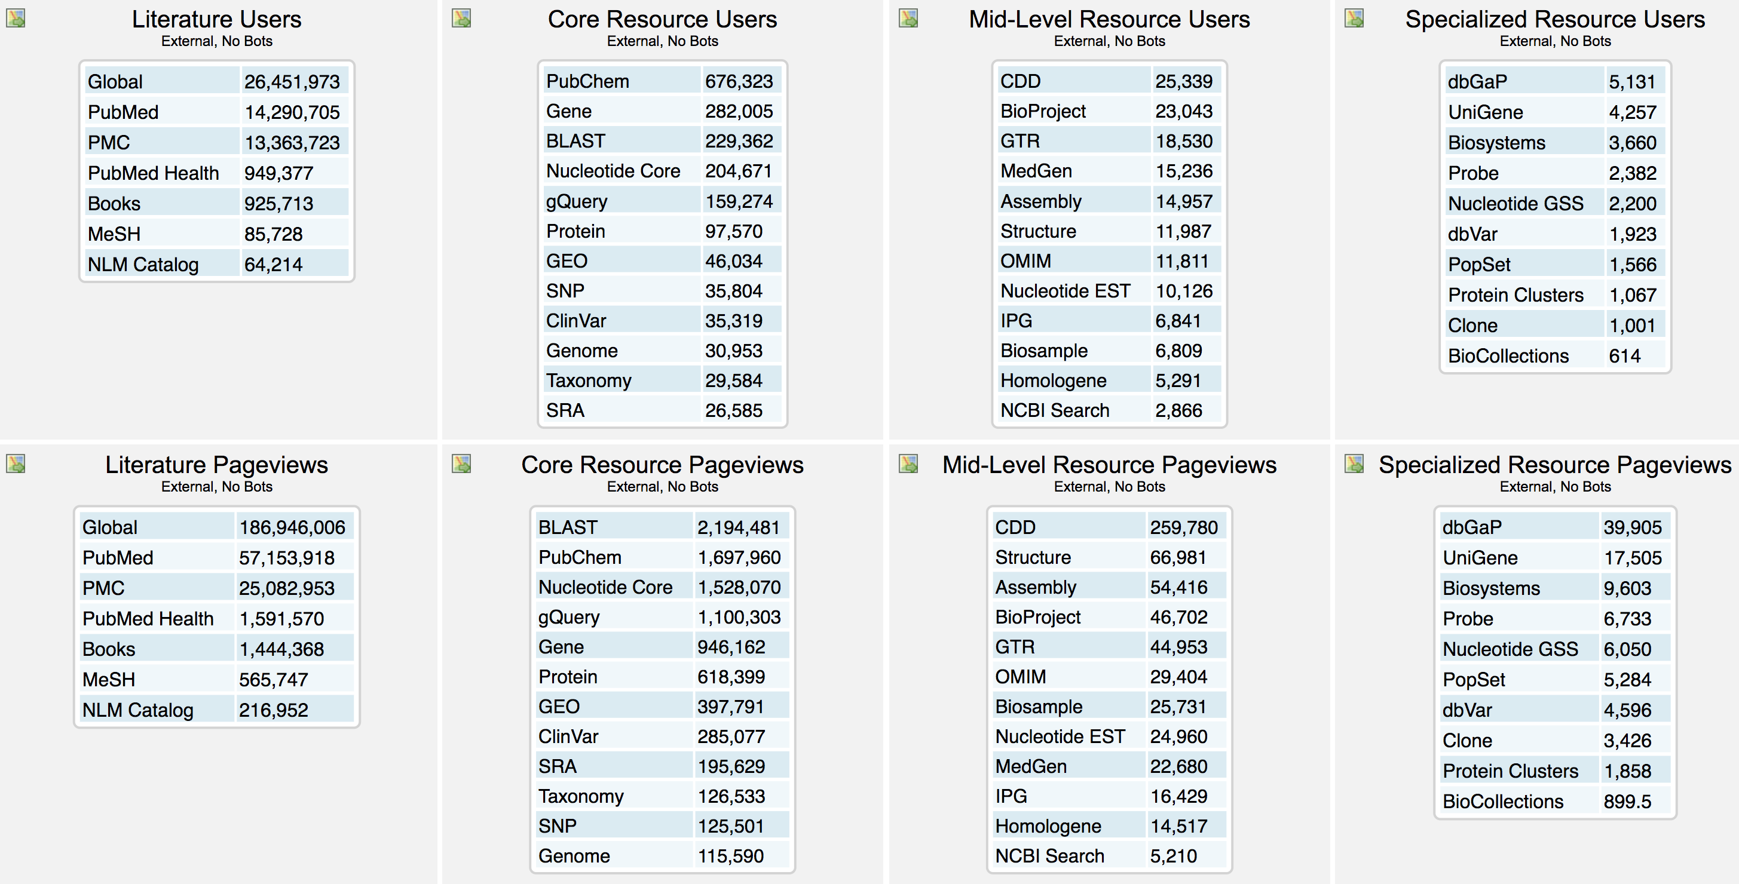
NCBI Usage Statistics (per week)

